Slide 1
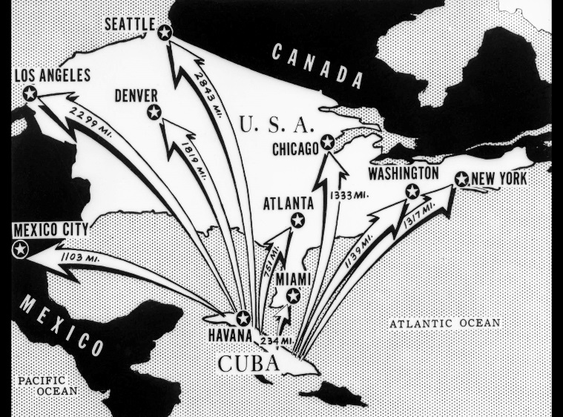
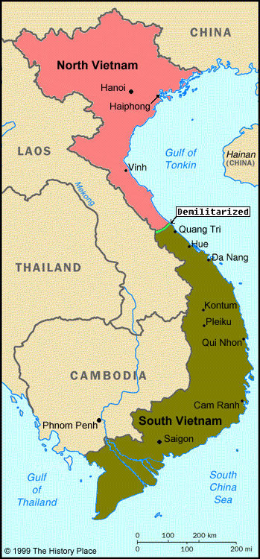
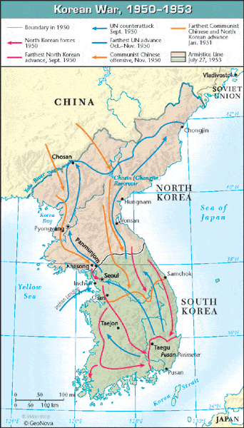
Review Videos: The Cold War
Cuban Missile Crisis documentary
https://youtu.be/Ig8UdfQKXSY
Why Did America Fight the Korean War?
https://youtu.be/t44SbOyjEUM
Vietnam War
https://youtu.be/9e9GWdT2pEQ

Slide 2
America in the 20th Century The Cold War
Full Review
https://youtu.be/sSjZhKtMucU

